Slide 1
SMART WATER FOUNTAIN

Slide 2
INTRODUCTION
A smart water fountain is a modern and innovative device designed to provide clean and refreshing drinking water in a more efficient and user-friendly manner. Unlike traditional water fountains, which are often basic and offer limited functionality, smart water fountains incorporate advanced technology to enhance the user experience and promote sustainability. These fountains are becoming increasingly popular in public spaces, educational institutions, offices, and even homes due to their numerous benefits.

Slide 3
PROBLEM STATEMENT
In today's world, access to clean and safe drinking water is essential for public health and well-being. Traditional water fountains, while functional, often present various challenges and limitations. During day-to-day activities many people often forget to water their plants and thus it becomes challenging for them to keep their plants healthy and alive. Also, it is a challenge for farmers to maintain their fields and manage watering of plants during shortage of water. Irregular watering leads to the mineral loss in the soil and may end up with rotting the plants.

Slide 4
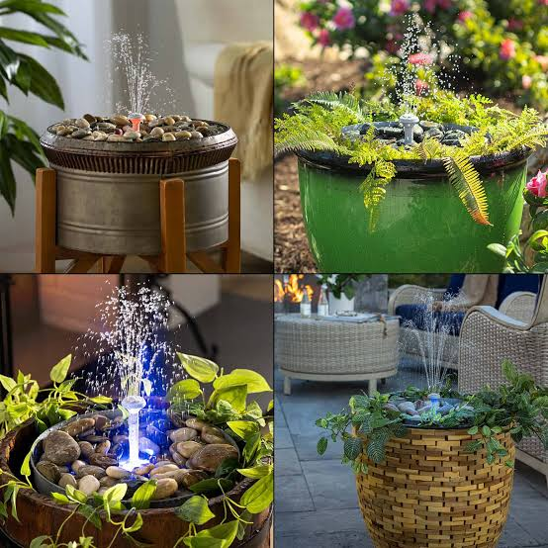
METHODOLOGY
DATA ANALYTICS
SAFETY MEASURES
MOTOR CONTROL
INTERNET CONNECTIVITY
USER INTERFACE
AUTOMATION
PROGRAMMING
IoT PLATFORM SELECTION
SENSOR

Slide 5
HARDWARE
1.Water Dispensing Mechanism: The core component responsible for dispensing water to users. It may include a faucet, spigot, or nozzle designed to deliver water efficiently.
2.Water Filtration System: A filtration system that removes impurities and contaminants from the water source, ensuring clean and safe drinking water.
3. Water Cooling System: If the fountain is intended to provide chilled water, it requires a cooling system, such as a refrigeration unit or a thermoelectric cooling module.
4. Water Heating System: For fountains that offer hot water, a heating system like a heating coil or tankless water heater is necessary.
5.Microcontroller or Microprocessor: A central processing unit (CPU) that controls the fountain's operations, manages sensor data, and executes commands. Common choices include Arduino, Raspberry Pi, or custom microcontroller.

Slide 6
6.sensors: Optional sensors like temperature and humidity sensors for environment monitoring.
7.Power supply: Ensure a stable power supply for the IoT device and the fountain components.
8.Internet connectivity: Choose a method for internet connectivity (Wi-fi, Ethernet, or cellular)for your IoT device.
9.LED: LED light is connected to appropriate digital pins on your microcontroller and also connect the current –limiting resistors in series with the LEDs.
10.Water Pump: Connect the positive wire(usually red)from the water pump to a digital pin on your microcontroller(e.g., pin9)and the negative wire(usually black or brown)to the microcontroller’s ground (GND).
11.Tubing: Set up the tubing to ensure water flows from the pump to the desired locations in your fountain.

Slide 7
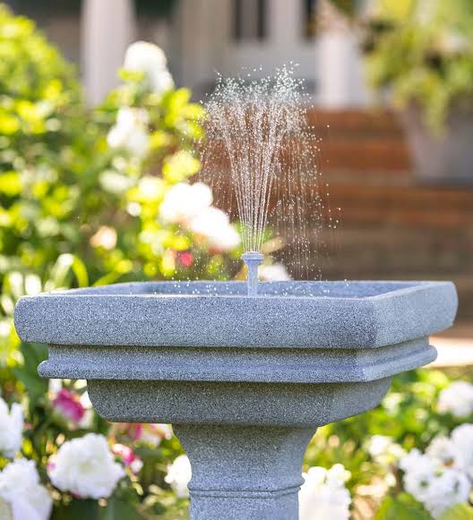
PROBLEM SOLUTION
The project is to design a smart water fountain that can monitor the water quality and automatically replace water polluted(not healthy)or running out.
Problem solutions are Touchless Operation, Water Filtration System, Bottle Refill Station, Temperature Control, User Engagement, Data Analytics, Maintenance Alerts, Accessibility Features, Remote Monitoring, Sustainability Promotion, Integration with Mobile Apps. Touchless operation reduces germ transmission. Filtration systems ensure clean and safe drinking water. Reduces plastic bottle waste and promotes sustainability. Encourages hydration through tracking and reminder. Inclusivity features cater to users with disabilities. Proactive maintenance alerts prevent issues.
Over time, using a smart water fountain is cost-effective compared to buying bottled water.

Slide 8
CONCLUSION
In conclusion, smart water fountains represent a significant advancement in the way we access and consume drinking water. They combine convenience, hygiene, sustainability, and technology to provide a modern and efficient solution for quenching our thirst in various settings. As technology continues to evolve, smart water fountains are likely to become even more prevalent, further improving our access to clean and refreshing drinking water.

Slide 9
THANK YOU

